Slide 1



SYNCURE
By Team Yijiaren

Slide 2

SYNCURE
Outdated Doctor Schedules, services and contact info
Most clinics lack technical personnel
PROBLEM STATEMENT
Patients confused by inconsistent or missing information

Slide 3




SYNCURE
Outdated Doctor Schedules, services and contact info
Most clinics lack technical personnel
Patients confused by inconsistent or missing information
PROBLEM STATEMENT

Slide 4
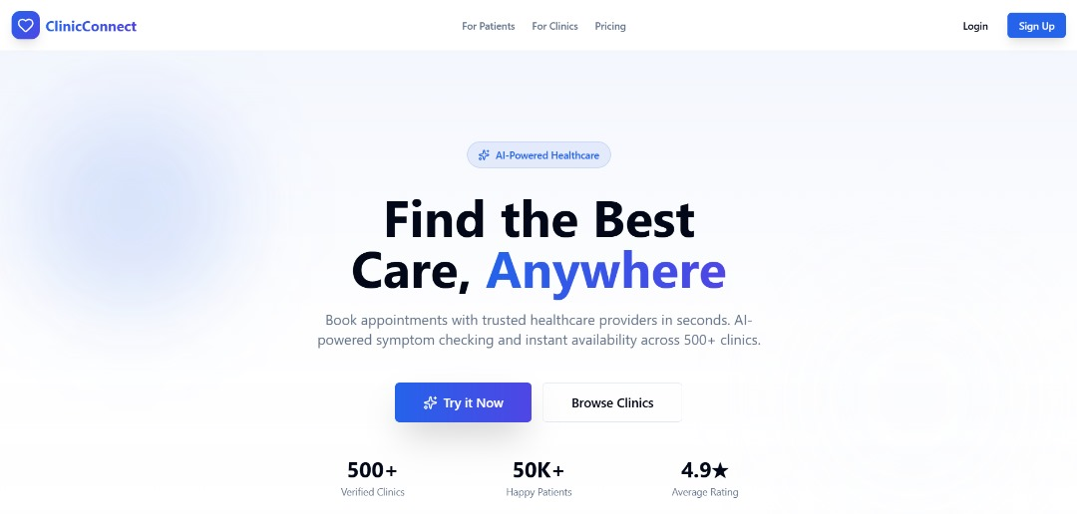
SYNCURE
INTRODUCTIING

Slide 5
SYNCURE
A healthcare website that maintains itself.
No technicians.
No manual edits.
No outdated information.

Slide 6

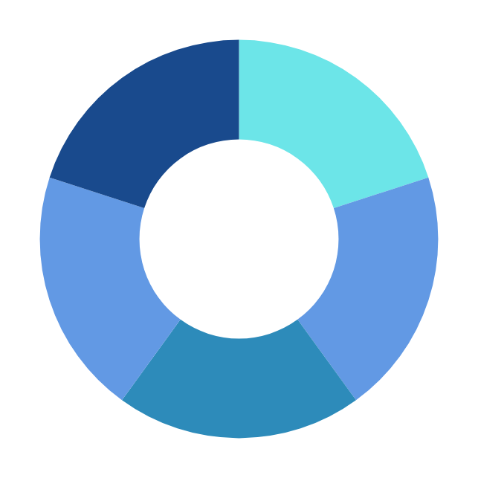
SYNCURE
“Is Dr Kang in tomorrow?”
“How to deal with red itchy skin?”
“What time do you close tomorrow?”
“I’m injured. Where is the nearest clinic?”
REPETITIVE QUESTIONS?

Slide 7
SYNCURE
“He has a slot at 8:00 pm”
“You can try to apply honey.”
“We are always open 24 hours.”
“The closest clinic near you is UM clinic.”
HANDLES PATIENT’S FAQ

Slide 8



SYNCURE
Provides clinic hours, doctor availability, services, and treatment info.
AI CHAT ASSISTANT
Understands symptoms and guides users to relevant services.
Supports appointment booking and navigation.

Slide 9
SYNCURE
CORE FEATURE
KNOWLEDGE TABLE

Slide 10



UPDATE YOUR
KNOWLEDGE TABLE
WITH ZERO HASSEL.

Slide 11
THANK YOU

